Slide 1
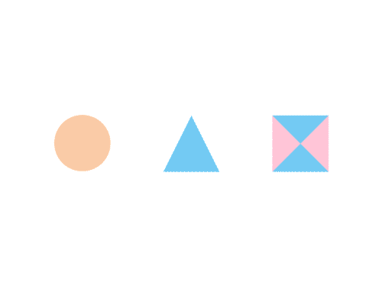

CSE 470/598 Viewing
Ross Maciejewski
rmacieje@asu.edu

Slide 2
Refresher
Matrix composition:
If I want to have an object that’s currently located at position (a, b, c) to be
1) Uniformly scaled by 3
2) Rotated around the z-axis by 45 degrees
3) Translated by (5, 10, 15)
Write out the sequence of matrices that you need to apply
Now write out the inverse of this transformation matrix

Slide 3
Questions?

Slide 4
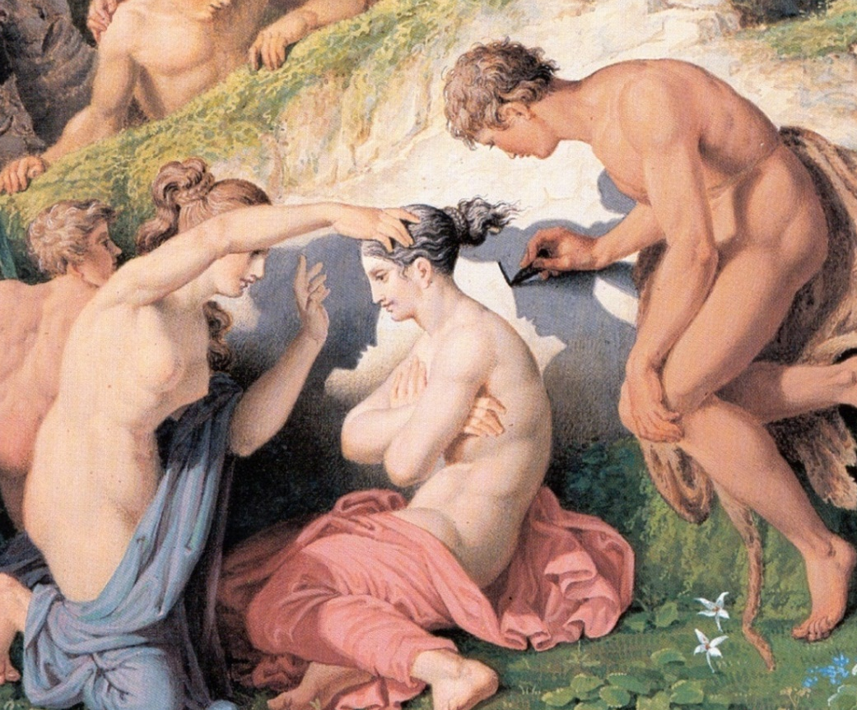
Drawing as Projection (Turning 3D to 2D)
Painting based on mythical tale as told by Pliny the Elder: Corinthian man traces shadow of departing lover
Projection through use of shadows
Detail from: The Invention of Drawing (1830) Karl Friedrich Schinkle (Mitchel p.1)

Slide 5

Early Forms of Projection
Plan view (parallel, specifically orthographic, projection) from Mesopotamia (2150 BC): Earliest known technical drawing in existence
Greek vase from the late 6th century BC: Shows signs of attempts at perspective!
Note relative sizes of thighs and lower legs of minotaur
Carlbom Fig. 1-1
Theseus Killing the Minotaur by the Kleophrades Painter

Slide 6
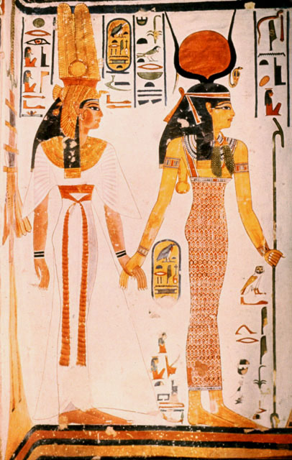
Early Forms of Projection
Ancient Egyptian Art:
Multiple Viewpoints
Parallel Projection
Tomb of Nefertari, Thebes (19th Dyn, ~1270 BC), Queen led by Isis. Mural
Note how the depiction of the body implies a front view but the feet and head imply side view (early cubism)

Slide 7
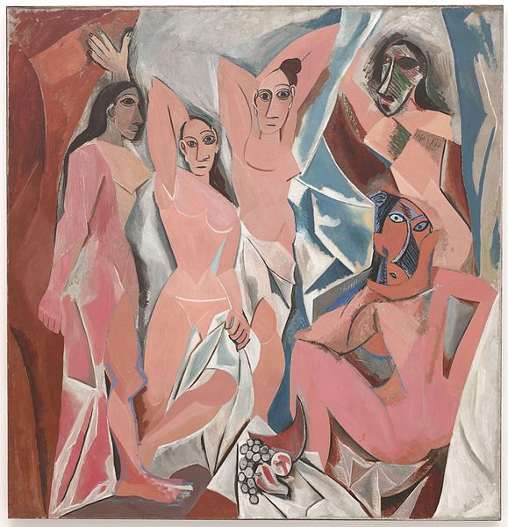
Early Forms of Projection
Pablo Picasso, Les Demoiselles d’Avignon, 1907

Slide 8
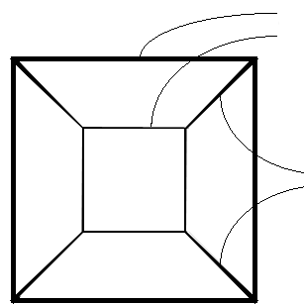
Linear Perspective
Parallel lines converse (in 1, 2, or 3 axes) to vanishing point(s).
Objects farther away are more foreshortened (i.e., smaller) than closer ones
edges same size,
with farther ones smaller
Example: perspective cube
parallel edges converging

Slide 9
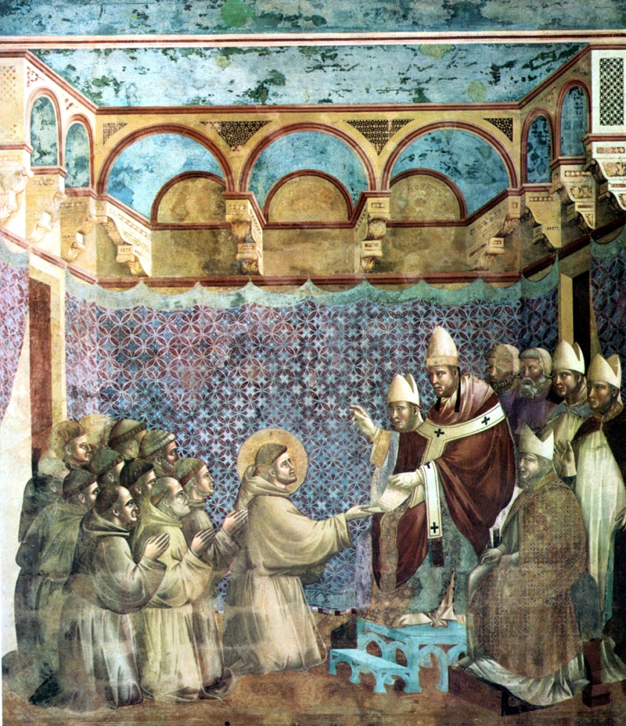
Early Attempts at Perspective
In art, an attempt to represent 3D space more realistically
Earlier works invoke a sense of 3D space but not systematically
Giotto
Franciscan Rule Approved
Assisi, Upper Basilica
c.1295-1300

Slide 10
Early Attempts at Perspective
Lines converge, but no single vanishing point
Giotto
Franciscan Rule Approved
Assisi, Upper Basilica
c.1295-1300

Slide 11
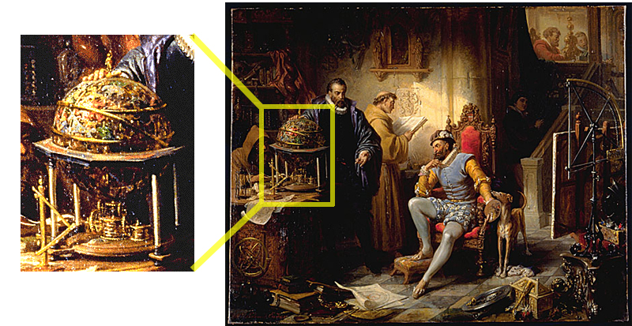
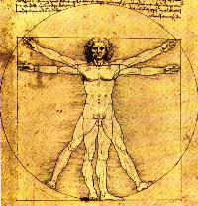
Background for Inventing Perspective Projection
Starting in the 13th century (AD): New emphasis on importance of individual viewpoint, world interpretation, power of observation (particularly of nature: astronomy, anatomy, etc)
Massaccio
Donatello
Leonardo
Newton
Ender, Tycho Brahe and Rudolph II in Prague
(detail of clockwork), c. 1855
Universe as clockwork: rebuilding the universe more systemically and mechanically

Slide 12
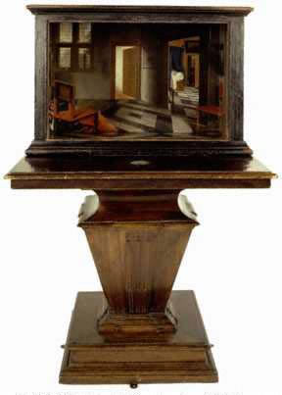
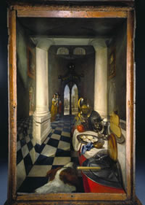
Brunelleschi and Vermeer
Brunelleschi invented systematic method of determining perspective projections (early 1400’s). He created demonstration panels with specific viewing constraints for complete accuracy of reproduction. Note the perspective is accurate only from one Point of View (POV)
Vermeer created perspective boxes where picture, when viewed through viewing hole, had correct perspective
Vermeer on the web:
http://www.grand-illusions.com/articles/ mystery_in_the_mirror/
http://essentialvermeer.20m.com/
http://brightbytes.com/cosite/what.html
Perspective Box Samuel van Hoogstraten National Gallery, London
Perspective Box of a Dutch Interior Samuel van Hoogstraten National Gallery, London

Slide 13
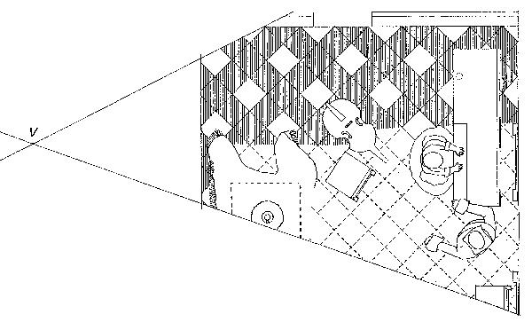
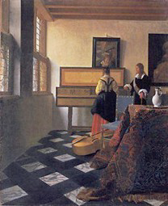
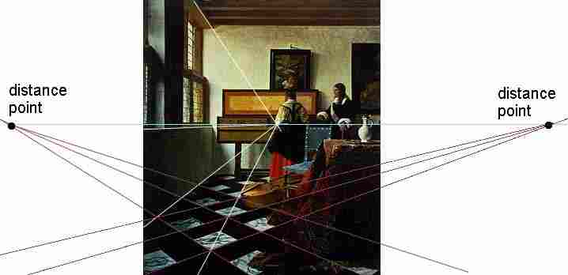
Vermeer, “The Music Lesson”

Slide 14
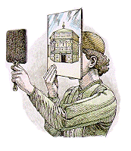
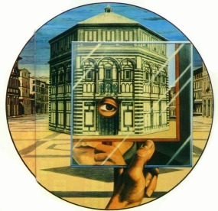
Brunelleschi’s Method
painting
Brunelleschi was reported to have used this setup to determine the accuracy of his paintings
The realism of his paintings are evidence that Brunelleschi had some systematic method for determining perspective projections, although the procedure he used was never documented
His illusion inspired other artists to explore linear perspective
mirror
baptistry
(Perception, Illusion and
Visual Art, William Warren)

Slide 15
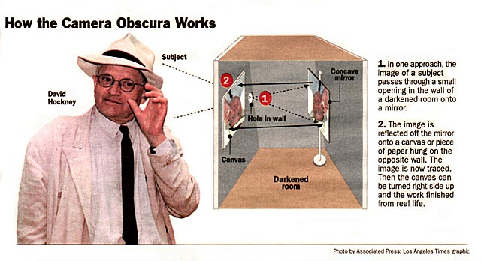
Camera Obscura
Hockney, D. (2001) Secret
Knowledge: Rediscovering
the Lost Techniques of
the Old Masters.
An artist named David Hockney proposed that many Renaissance artists, including Vermeer, might have been aided by camera obscura while painting their masterpieces, raising a big controversy
David Stork, a Stanford optics expert, refuted Hockney’s claim in the heated 2001 debate about the subject among artists, museum curators and scientists. He also wrote the article “Optics and Realism in Renaissance Art”, using scientific techniques to disprove Hockney’s theory

Slide 16
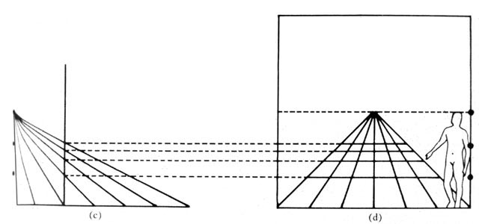
Linear Perspective - Vanishing Points
Both Da Vinci and Alberti created accurate geometric ways of incorporating linear perspective into a drawing using the concept vanishing points
“Little Space”
perpendicular
Battista Alberti’s Method
Eye
diagonals
transversals
Credit Perception, Illusion and Visual Art, William Warren
baseline
http://zimmer.csufresno.edu/~dellad/html%20/alberticonstruction.html

Slide 17
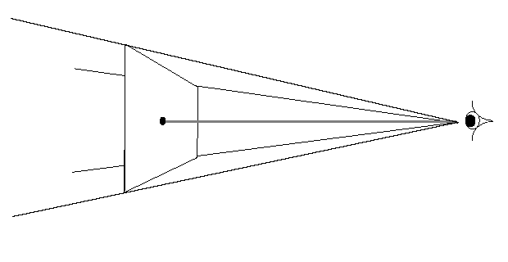
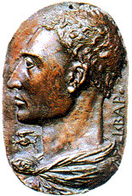
Alberti on Linear Perspective
Published first treatise on perspective, Della Pittura, in 1435
“A painting [the projection plane] is the intersection of a visual pyramid [view volume] at a given distance, with a fixed center [center of projection] and a defined position of light, represented by art with lines and colors on a given surface [the rendering].” (Leono Battista Alberti (1404-1472), On Painting, pp. 32-33)

Slide 18
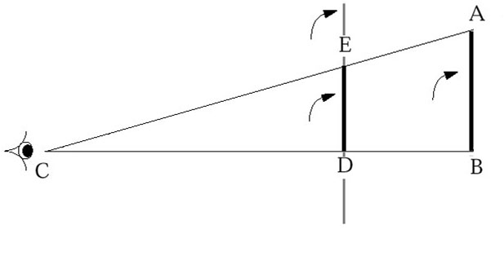
Visual Pyramid and Geometry
Idea of “visual pyramid” implies use of triangular geometry
Easy to project object on to an image plane based on
height of object (AB)
distance from eye to object (CB)
distance from eye to picture (projection) plane (CD)
and using relationship CB: CD as AB: ED
CB : CD as AB: ED

Slide 19
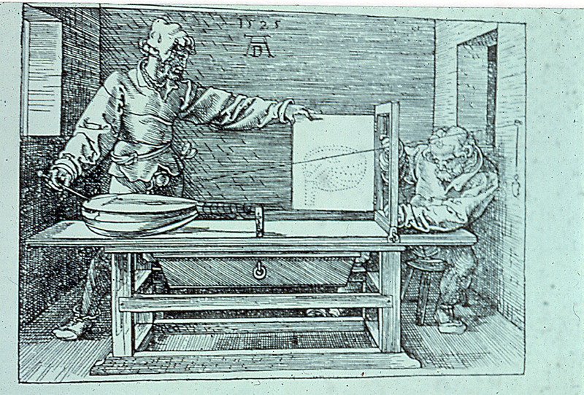
Dürer Woodcut
Concept of similar triangles described both geometrically and mechanically in widely read treatise by Albrecht Dürer (1471-1528)
Refer to chapter 3 of the book for more details
Albrecht Dürer
Artist Drawing a Lute
Woodcut from Dürer’s work about the Art of Measurement. ‘Underweysung der messung’, Nurenberg, 1525

Slide 20
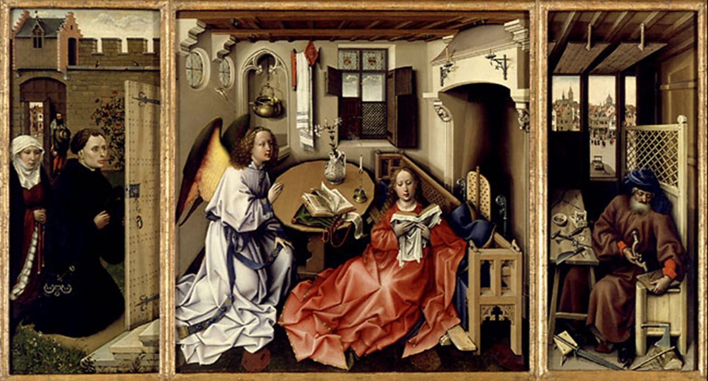
Art of Perspective
Robert Campin - The Annunciation Triptych (ca. 1425)

Slide 21
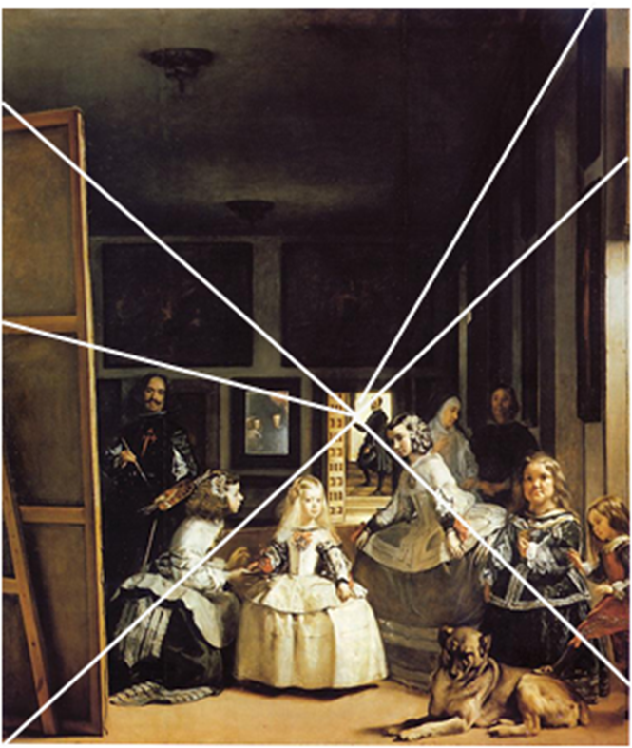
Art of Perspective
Point of view influences content and meaning of what is seen
Are royal couple in mirror about to enter room? Or is their image a reflection of painting on far left?
Analysis through computer reconstruction of the painted space
royal couple in mirror is reflection from canvas in foreground, not reflection of actual people (Kemp pp. 105-108)
Las Meninas (1656) by Diego Velàzquez

Slide 22
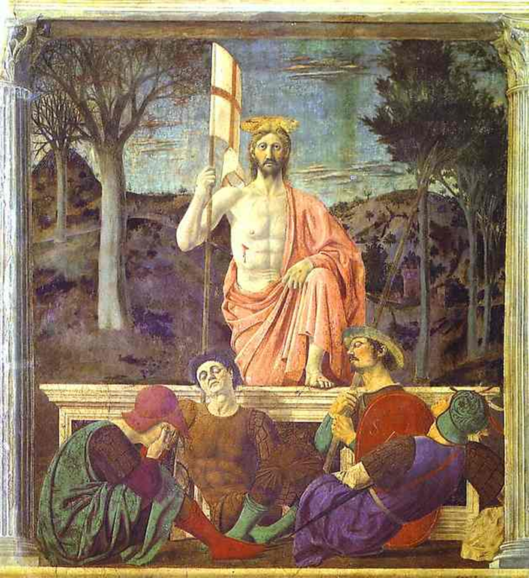
Art of Perspective
Perspective can be used in unnatural ways to control perception
Piero della Francesca The Resurrection (1460)

Slide 23
Art of Perspective
Perspective can be used in unnatural ways to control perception
Use of two viewpoints concentrates viewer’s attention alternately on Christ and sarcophagus
Piero della Francesca The Resurrection (1460)

Slide 24
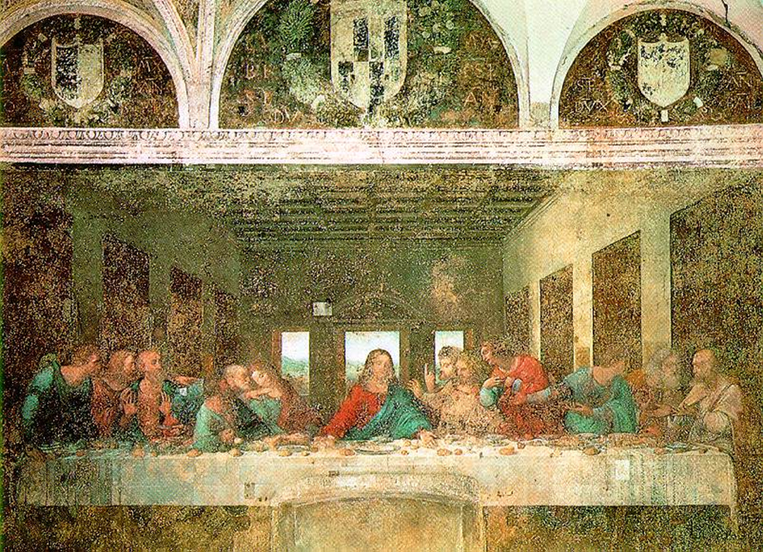
Art of Perspective
Leonardo da Vinci The Last Supper (1495)

Slide 25
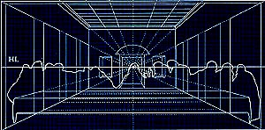
Art of Perspective
Perspective plays an important role in this painting
Leonardo da Vinci The Last Supper (1495)

Slide 26
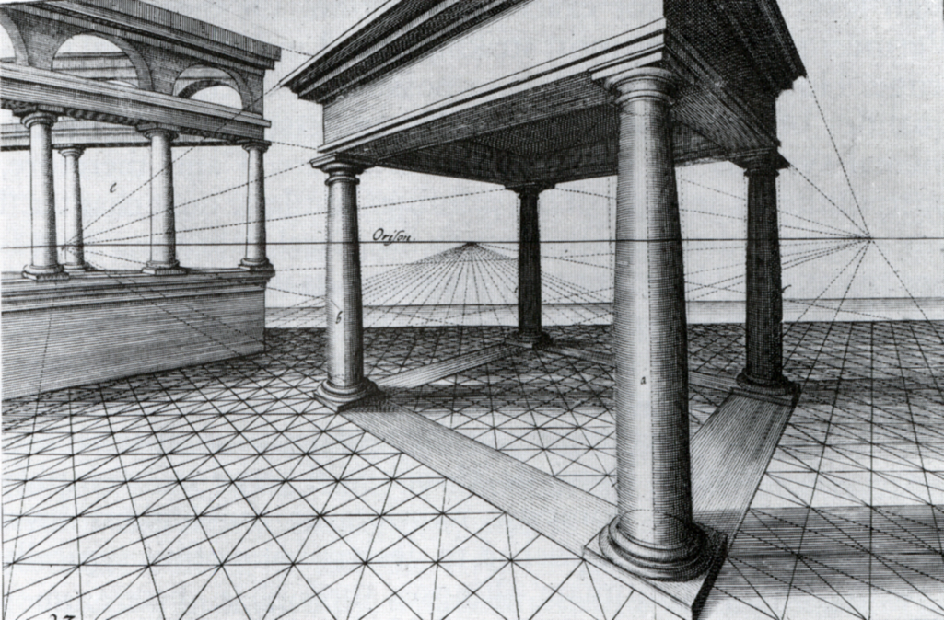
Art of Perspective
Vredeman de Vries’s Perspective (1619)
Two vanishing points, two point perspective

Slide 27
Questions?

Slide 28
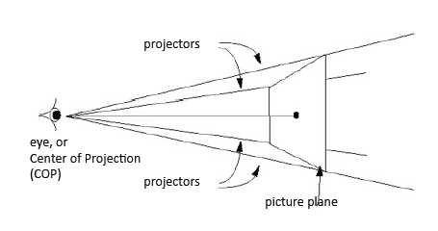
Planar Geometric Projection
Projectors are straight lines, like the string in Dürer’s “Artist Drawing a Lute”.
Projection surface is plane (picture plane, projection plane)

Slide 29
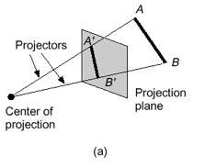
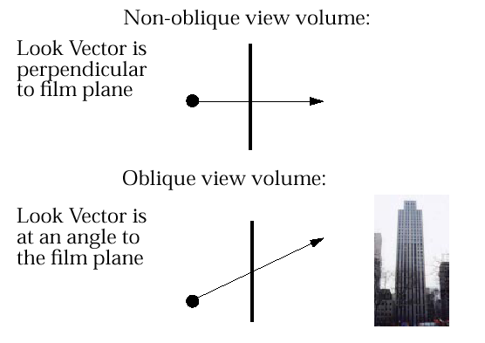
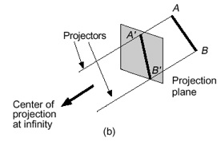
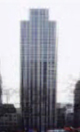
Two Classes of Planar Geometric Projections
Perspective
determined by Center of Projection (COP) (in our diagrams, the “eye”)
Parallel
determined by Direction of Projection (DOP) (projectors are parallel—do not converge to “eye” or COP). Alternatively, COP is at ∞

Slide 30
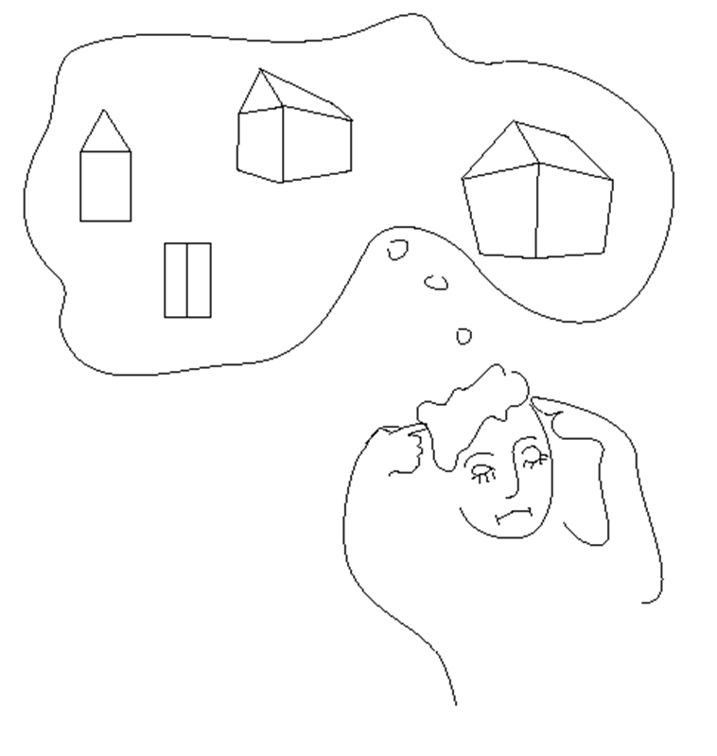
Types of Projections

Slide 31
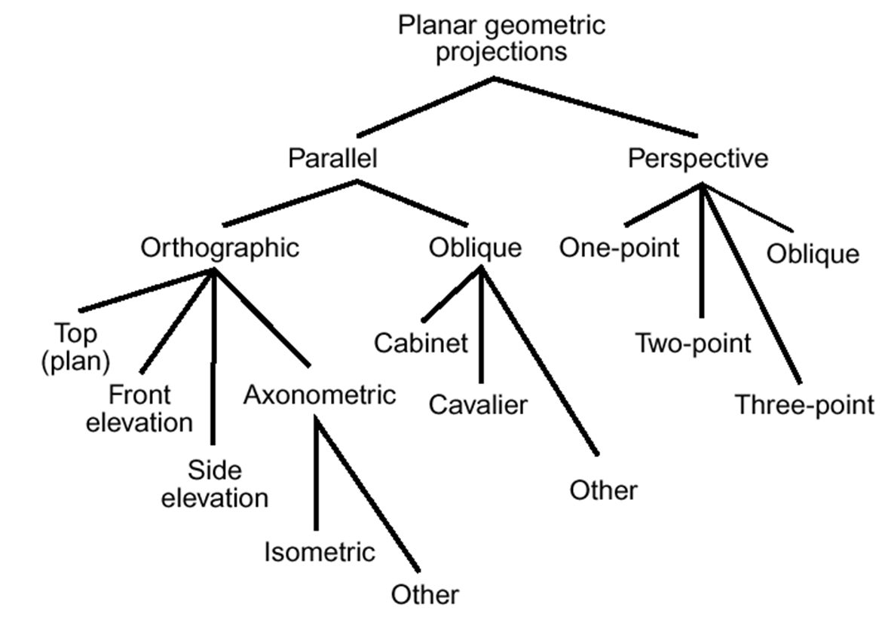
Types of Projections

Slide 32
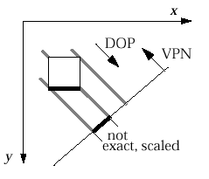
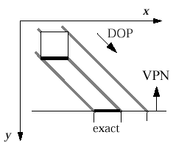
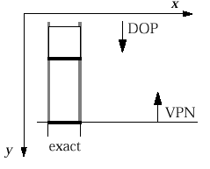
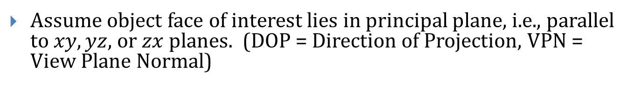
Overview of Parallel Projections
Assume object face of interest lies in principal plane, i.e., parallel to $xy, yz,$or $zx$planes. (DOP = Direction of Projection, VPN = View Plane Normal)
1) Multiview Orthographic
VPN || a principal coordinate axis
DOP || VPN
shows single face, exact measurements
2) Axonometric
NOT (VPN || a principal) coordinate axis
DOP || VPN
adjacent faces, none exact, uniformly foreshortened (function of angle between face normal and DOP)
3) Oblique
VPN || a principal coordinate axis
NOT (DOP || VPN)
adjacent faces, one exact, others uniformly foreshortened

Slide 33
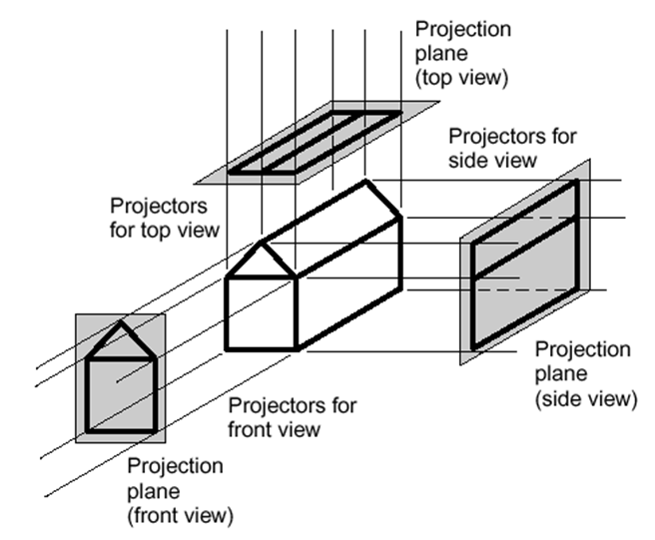
MultiView Orthographic (Parallel)
Used for:
engineering drawings of machines, machine parts
working architectural drawings
Pros:
accurate measurement possible
all views are at same scale
Cons:
does not provide “realistic” view or sense of 3D form
Usually need multiple views to get a three-dimensional feeling for object

Slide 34
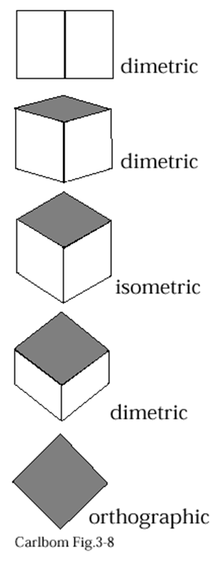
Axonometric (Parallel)
Same method as multiview orthographic projections, except projection plane not parallel to any of coordinate planes; parallel lines equally foreshortened
Isometric: Angles between all three principal axes equal (120º). Same scale ratio applies along each axis
Dimetric: Angles between two of the principal axes equal; need two scale ratios
Trimetric: Angles different between three principal axes; need three scale ratios

Slide 35
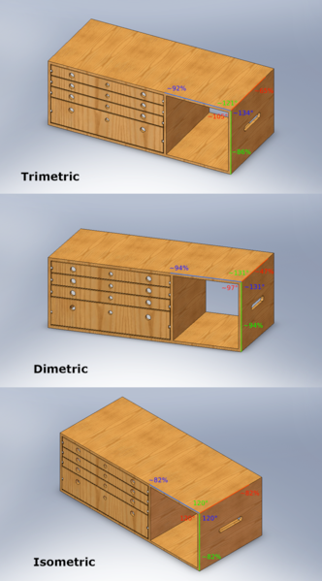
Axonometric (Parallel)
Same method as multiview orthographic projections, except projection plane not parallel to any of coordinate planes; parallel lines equally foreshortened
Isometric: Angles between all three principal axes equal (120º). Same scale ratio applies along each axis
Dimetric: Angles between two of the principal axes equal; need two scale ratios
Trimetric: Angles different between three principal axes; need three scale ratios

Slide 36
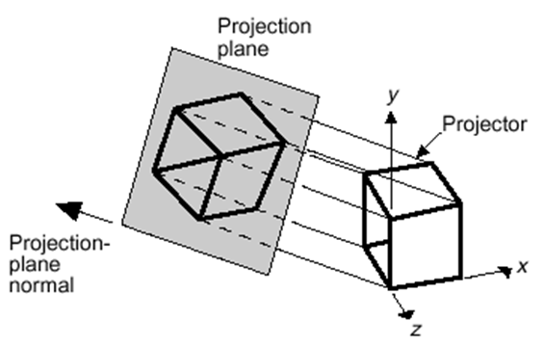
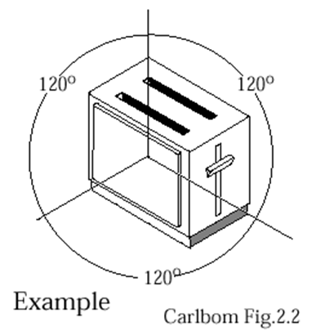
Isometric Projection
Used for:
catalogue illustrations
patent office records
furniture design
structural design
3d Modeling in real time (Maya, AutoCad, etc.)
Pros:
don’t need multiple views
illustrates 3D nature of object
measurements can be made to scale along principal axes
Cons:
lack of foreshortening creates distorted appearance
more useful for rectangular than curved shapes
Construction of an isometric projection:
projection plane cuts each principal axis by 45°

Slide 37
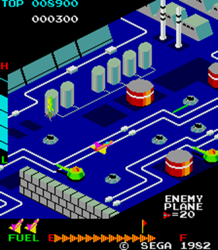

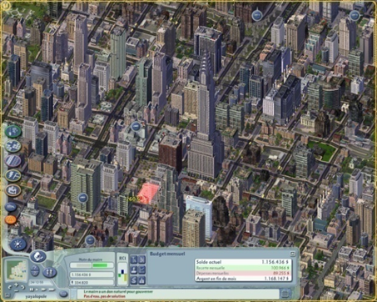
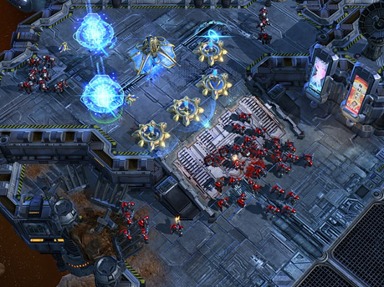
Axonometric Projection in Games
Video games have been using isometric projection for ages
Started in 1982 with Q*Bert and Zaxxon
Still used today when you want to see things in distance as well as things close up (e.g., strategy, simulation games)
Not the strength of perspective
SimCity IV
StarCraft II

Slide 38
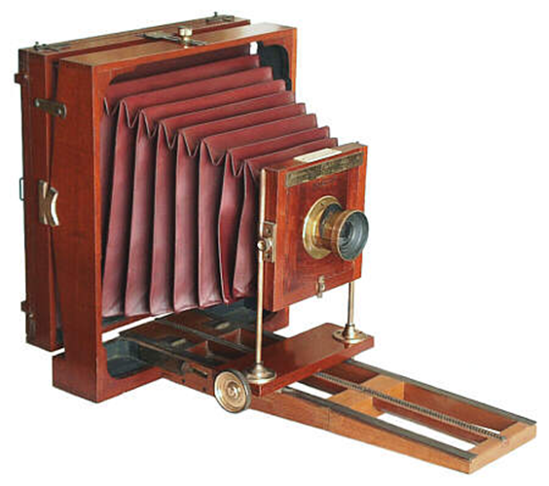
Oblique Projection (Parallel)
Projectors at oblique angle to projection plane; view cameras have accordion housing, can adjust the projection plane
Pros:
can present exact shape of one face of an object (can take accurate measurements): better for elliptical shapes than axonometric projections, better for “mechanical” viewing
lack of perspective foreshortening makes comparison of sizes easier
displays some of object’s 3D appearance
Cons:
objects can look distorted if careful choice not made about position of projection plane (e.g., circles become ellipses)
lack of foreshortening (not realistic looking)

Slide 39
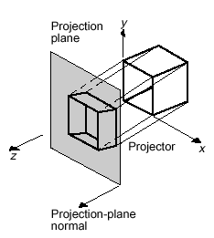
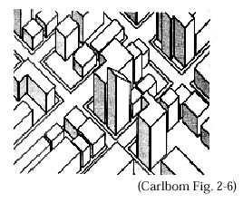
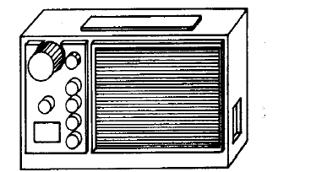
Examples of Oblique Projections
Plan oblique projection of city
Construction of
oblique parallel projection
(Carlbom Fig. 2-4)
Front oblique projection of radio

Slide 40




Rules for Constructing Oblique Views
Rules for placing projection plane for oblique views: projection plane should be chosen according to one or several of following:
parallel to most irregular of principal faces, or to one which contains circular or curved surfaces
parallel to longest principal face of object
parallel to face of interest
Projection plane parallel to circular face
Projection plane not parallel to circular face

Slide 41





Main Types of Oblique Projections
Cavalier: Angle between projectors and projection plane is 45$°$. Perpendicular faces projected at full scale
Cabinet: Angle between projectors and projection plane: arctan(2) = 63.4$°$. Perpendicular faces projected at 50% scale

Slide 42

Examples of Parallel Projection
multiview orthographic
cavalier
cabinet

Slide 43

Example
Comparison of different types of cameras:
Perspective
Axonometric
Isometric
Dimetric
Trimetric
Oblique

Slide 44
Questions?

Slide 45

Perspective Projection
Used for:
Human visual system…
Pros:
gives a realistic view and feeling for 3D form of object
Cons:
does not preserve shape of object or scale (except where object intersects projection plane)
Different from a parallel projection because
parallel lines not parallel to the projection plane converge
size of object is diminished with distance
foreshortening is not uniform
Two understandings: Vanishing Point and View Point
If we were viewing this scene using parallel project, the tracks would not converge

Slide 46


Vanishing Points
Lines extending from edges converge to common vanishing point(s)
For right-angled forms whose face normals are perpendicular to the x, y, z coordinate axes:
number of vanishing points = number of principal coordinate axes intersected by projection plane
z
One Point Perspective
(z-axis vanishing point)
Two Point Perspective
(z, and x-axis vanishing points)
Three Point Perspective
(z, x, and y-axis vanishing points)

Slide 47

The Single Viewpoint
Art employs the vanishing point idea while computer graphics uses the viewpoint concept
where the viewpoint is the virtual camera
Basic concept of a ray tracer
Also applies to the idea of the similar triangle

Slide 48


Vanishing Points and Viewpoint
So what is the relation between Vanishing Points and the Viewpoint?
Intuitively, they must be related because changing the Viewpoint will change the numbers and the locations of the vanishing points…

Slide 49

Vanishing Points and Viewpoint
Combining the 2
Still, what is the relationship?

Slide 50


Vanishing Points and Viewpoint
Project parallel lines AB, CD onto the projection plane
Projection lines from eye to AB and CD define 2 planes, which meet in a line that contains the eye (the viewpoint)
This line does not intersect the projection plane because it is parallel to it. Therefore there is no vanishing point.

Slide 51


Vanishing Points and Viewpoint
Project parallel lines A’B, C’D onto the projection plane
Projection lines from eye to A’B and C’D define 2 planes, which meet in a line that contains the eye (the viewpoint)
This line does intersect the projection plane.
Point of intersection = vanishing point

Slide 52
Questions?

Slide 53
Synthetic Camera
Synthetic camera is the goal of assignment 3:
create a camera in software that can project a 3D scene onto a 2D screen
Generally speaking, a 3D synthetic camera contains:
Camera position
Orientation
Field of view (view angle: wide, narrow, etc.)
Depth of field (near distance, far distance)
Focal distance (blurring)
Tilt of view/film plane (if not perpendicular to viewing direction will produce oblique projection)
Perspective of parallel projection
For your assignment, you will be building a simpler version of the generalized model in that you can omit:
Tilt of view/film plane
Focal distance

Slide 54

The Pinhole model
We can think of the synthetic camera as a pinhole.
As you look through the pinhole, you see a certain volume of space.
Rays of light reflect off objects and converge to the pinhole to let you see the scene
Similar to the ideas we’ve discussed earlier
In this model:
Pinhole = camera position
Volume of space = view volume
Create a projection plane that is the screen
Object
Pinhole
Image projected
on image plane

Slide 55



View Volume
A view volume contains everything visible from the camera’s perspective
Different types of View Volumes:
Conical – approximates what our eyes see.
Expensive math when clipping objects against cone’s surface (simultaneous quadratics)
Rectangular Frustum – an approximation of the conical representation
Math is easier – we only have simultaneous linear equations for clipping (see later lecture)
Parallel View Volume – for orthographic projections. These do not simulate eye or camera
eye
conical perspective view volume (eye’s is much wider)
frustum approximation, view volume
synthetic
camera
View volume
(Parallel view)

Slide 56


View Volumes and Projectors
Given our view volume, how do we project the scene contained in the volume onto a film plane?
Projectors: lines map points in the scene to points on the film plane
Parallel Volumes: Parallel projectors. All objects appear to be the same size (regardless of distance to the camera)
Perspective Volumes: Projectors converge on the eye point. Objects further away appear smaller.

Slide 57



Camera in Rendering
Deriving a 2D image from 3D view parameters is a hard problem. We make it easier by taking a picture from the canonical view volume.
Three steps:
Define the parameters for the view specification:
Position, look vector, up vector, aspect ratio, view angle, clipping planes
Transform the parameters into the camera space:
Position, look vector, up vector, aspect ratio, view angle, clipping planes
Transform to the canonical view volume, project, clip, and rasterize

Slide 58

OpenGL Matrix Transformation Pipeline
Input: list of 3D coordinates (x, y, z)
GL_MODELVIEW
Model transform (earlier)
View transform (today)
GL_PROJECTION
Projection transform
Clipping
Perspective division
Viewport
Viewport transform
Output: 2D coordinates for each input 3D coordinates

Slide 59

The Film Plane
Look Vector
The film plane is the plane in World Space (or World Coordinate) where the 3D scene is projected onto
Question: what do I mean when I say “World Coordinate”?
What about “Camera Coordinate”?
What about “Object Coordinate”?
Film for our camera model will be:
Perpendicular to the look vector
Centered around the look vector
Match the dimensions of our view volume
Actual location of the film plane doesn’t matter as long as it is in front of the scene
Film Plane
Look Vector
Film
Plane

Slide 60

Viewport
Viewport is the rectangular area of the screen where the scene is rendered
May be smaller than your window
glViewport (0, 0, width, height)
glViewport (40, 10, 60, 120)
Often referred to as the (u, v) coordinate system

Slide 61
Questions?

Slide 62

Constructing the View Volume
Up vector
Look vector
Position
We need to know 6 things about the synthetic camera model:
Position of the camera -> P (x, y, z)
Look vector -> V (x, y, z)
Up vector -> U (x, y, z)
Note that with look and up vectors, we know the orientation of the camera

Slide 63

Constructing the View Volume
Width angle
Height angle
Back clipping plane
Front clipping plane
Aspect ratio of the film (ratio of width to height)
View angle (or height angle): determines how “wide” the frustum will be
Note that the width angle can be inferred from the aspect ratio and the height angle
Front and back clipping planes: limit the extend of the camera’s view. Only render objects within the two planes
Optional parameter: focal length: often used for photorealistic rendering. Objects near the focal length are sharp (in focus), objects away from the focal lengths appear blurry.
Note that your camera does not have to implement focal length blurring

Slide 64

1. Position
Where is the camera located with respect to the origin?
For our camera in 3D space, we use a right-handed coordinate system
Open your right hand, align your palm and thumb with the +x axis, point your finger along the +y axis, and your middle finger will point towards the +z axis.
If you are looking at the screen, the z axis will be positive coming towards you
Means that you are typically looking down the negative z axis

Slide 65
2 & 3. Orientation: Look and Up Vectors
Where the camera is looking is specified by either:
A 3D point in space that you are looking at (the LookAt point), or
A direction in which your are looking towards (the look vector)
The orientation adds the rotation around the look vector
Which can be represented as the up vector
y
x
-z
Up vector
point to look at (x’, y’, z’)
Look vector
camera Position
z

Slide 66



2 & 3. Orientation: Look and Up Vectors
Look Vector
Direction the camera is point
3 degrees of freedom (can be any vector in 3-space)
Up Vector
Determines how camera is rotated around the Look Vector
For example, hold the camera horizontally or vertically
Up vector CANNOT be parallel to the Look Vector…
But doesn’t need to be perpendicular either (for ease of specification). The actual orientation will be defined by the part of the vector perpendicular to the look vector
Any of $v, v1, v2, v3$
could be the up vector
Look Vector
Up vector
Look vector
Projection of Up vector
Position

Slide 67


Camera Coordinate System (u, v, w)
w
-w
Some conventions use (u, v, n)
I find them equally confusing:
w = homogeneous coordinate system
n = normal

Slide 68

Camera Coordinate System (u, v, w)
The equivalent of x, y, z axes in camera space are unit vectors u, v, and w (or n).
Also a right handed coordinate system
w is a unit vector in the opposite direction of the look vector
v is the part of the up vector perpendicular to the look vector, normalized to unit length
u is the unit vector perpendicular to both v and w.

Slide 69


Camera Coordinate System (u, v, w)
There are three common transformations that use the u, v, w coordinate system
Roll: rotate around w
Yaw: rotate around v
Pitch: rotate around u

Slide 70

Finding (u, v, w)
Given the two parameters (lookV, and upV), find the values for (u, v, w)
Finding w is easy. Since w is defined as the opposite direction of the look vector:
$$w=\frac{−lookV}{\left|lookV\right|}$$

Slide 71
Finding (u, v, w)
Finding v: Problem: up vector does not have to be perpendicular to the look vector. So how do I find v given the up vector?
Let’s get back to that later.
We’ll try to find u first.

Slide 72

Finding (u, v, w)
Finding u.
We know that u is perpendicular to both v and w, but we don’t have v yet (only upV)
However, we do know that v is determined by a rotation around w. Therefore upV and w will span the same plane regardless of whether or not upV and w are perpendicular.
So to find u, we can use the cross product using :
Problem: $n×upV$ or $upV ×n$?
Given the right-hand rule, it should be $upV ×n$
$$u=\frac{upV ×n}{\left|upV×n\right|}$$

Slide 73

Finding (u, v, w)
Finding v.
Now that we have u and w, we can trivially compute v as the cross product of the w and u
Note: need to apply the right-hand rule again
$$v=w×u$$
Note that we don’t need to normalize v because w and u are already normalized.

Slide 74
Camera in OpenGL
Setting the Camera’s position and orientation in OpenGL
The Model-View Matrix is (conceptually) made up of 2 parts, but in OpenGL it is implemented as a single composite transform.
Model Transformation -> apply the transform to all the points in the world
View Transform -> transform these points from the world coordinates (x, y, z) into the camera’s coordinates (u, v, w)
Note that model transform is applied first, then the view transform
Question: why can we merge model and view transforms into one?

Slide 75
Camera as a model
(0,5,0)
(-1,5,0)
(0,5,0)
(0,0,0)
(0,0,0)
(1,0,0)
For rendering, the middle and right models create the same image.
Meaning that we can either think of model transform and view transforms as Inverses of each other
In OpenGL, we tend to use the middle model

Slide 76

World-To-Camera Transform
Sometimes referred to as “World-to-Eye” transform.
The idea is to create a matrix such that we make the camera:
1) move to the origin of the World Coordinate (x, y, z)
2) rotate to align (u, v, w) with (x, y, z)

Slide 77

World-To-Camera: Translate
1) Move the camera to the origin
That’s pretty easy, just a regular translation matrix
We want to transform $\left(e_{x}, e_{y}, e_{z}\right)$ to $(0, 0, 0)$
So we want to translate by $\left(−e_{x}, {−e}_{y}, {−e}_{z}\right)$
$$T= \left[\begin{matrix}\begin{aligned}1 \\ 0 \\ 0 \\ 0\end{aligned} & \begin{aligned}0 \\ 1 \\ 0 \\ 0\end{aligned} & \begin{matrix}\begin{aligned}0 \\ 0 \\ 1 \\ 0\end{aligned} & \begin{aligned}−e_{x} \\ −e_{y} \\ −e_{z} \\ 1\end{aligned}\end{matrix}\end{matrix}\right]$$

Slide 78
World-To-Camera: Rotation
Translation is easy, but how do we rotate a set of axes to another?
What would this rotation matrix look like?
Hint, think about basis vectors…

Slide 79

Recall Basis Vectors
Remember that:
Columns of a transformation matrix denote the basis vectors of a matrix.
We know this because:
$\left[\begin{matrix}1 & 1 \\ 1 & 2\end{matrix}\right]\left[\begin{matrix}1 \\ 0\end{matrix}\right]=\left[\begin{matrix}1 \\ 1\end{matrix}\right]$ $\left[\begin{matrix}1 & 1 \\ 1 & 2\end{matrix}\right]\left[\begin{matrix}0 \\ 1\end{matrix}\right]=\left[\begin{matrix}1 \\ 2\end{matrix}\right]$
So in this sense, the matrix above maps the x-axis (1, 0) to the u-axis (1, 1), and maps the y-axis (0, 1) to the v-axis (1, 2)
So what would the new rotation matrix look like?
Hint, first try the non-homogeneous coordinate (3x3 matrix)

Slide 80

World-To-Camera: Rotation
So, the following matrix will map from (x, y, z) to (u, v, w):
$$R_{xyz2uvw}=\left[\begin{matrix}\begin{aligned}u_{x} \\ u_{y} \\ u_{z} \\ 0\end{aligned} & \begin{aligned}v_{x} \\ v_{y} \\ v_{z} \\ 0\end{aligned} & \begin{matrix}\begin{aligned}w_{x} \\ w_{y} \\ w_{z} \\ 0\end{aligned} & \begin{aligned}0 \\ 0 \\ 0 \\ 1\end{aligned}\end{matrix}\end{matrix}\right]$$

Slide 81

World-To-Camera: Rotation
Problem!
We need (u, v, w) to (x, y, z)!
$$R_{xyz2uvw}=\left[\begin{matrix}\begin{aligned}u_{x} \\ u_{y} \\ u_{z} \\ 0\end{aligned} & \begin{aligned}v_{x} \\ v_{y} \\ v_{z} \\ 0\end{aligned} & \begin{matrix}\begin{aligned}w_{x} \\ w_{y} \\ w_{z} \\ 0\end{aligned} & \begin{aligned}0 \\ 0 \\ 0 \\ 1\end{aligned}\end{matrix}\end{matrix}\right]$$
So we need to have $R_{xyz2uvw}^{−1}$
What is the inverse of a rotation matrix?

Slide 82

Recall: Inverse of Rotation Matrix is its Transpose
From the lecture Transform 3:
The inverse of a Rotation Matrix $R_{θ}$ is the same as its transpose $R_{θ}^{T}$.
In other words, $R_{θ}^{−1}=R_{θ}^{T}$
Let’s prove this… First, we note the properties of $R_{θ}=\left[\begin{matrix}v_{1} & v_{2} & v_{3}\end{matrix}\right]$ :
Columns are orthogonal to each other (e.g., $v_{1}∙v_{2}=0)$
Columns represent unit vectors: $\left\|v_{i}\right\|=0$
Let’s multiply ${R_{θ}^{T} by R}_{θ}$:
$\left[\begin{matrix}v1_{x} & v1_{y} & v1_{z} \\ v2_{x} & v2_{y} & v2_{z} \\ v3_{x} & v3_{y} & v3_{z}\end{matrix}\right]$ $\left[\begin{matrix}v1_{x} & v2_{x} & v3_{x} \\ v1_{y} & v2_{y} & v3_{y} \\ v1_{z} & v2_{z} & v3_{z}\end{matrix}\right]$ = $\left[\begin{matrix}v1∙v1 & v1∙v2 & v1∙v3 \\ v2∙v1 & v2∙v2 & v2∙v3 \\ v3∙v1 & v3∙v2 & v3∙v3\end{matrix}\right]$

Slide 83

World-To-Camera: Rotation
So $R_{xyz2uvw}^{−1}=R_{xyz2uvw}^{T}$
$$R_{xyz2uvw}^{−1}=R_{xyz2uvw}^{T}=R_{uvw2xyz}$$
$$=\left[\begin{matrix}\begin{aligned}u_{x} \\ v_{x} \\ w_{x} \\ 0\end{aligned} & \begin{aligned}u_{y} \\ v_{y} \\ w_{y} \\ 0\end{aligned} & \begin{matrix}\begin{aligned}u_{z} \\ v_{z} \\ w_{z} \\ 0\end{aligned} & \begin{aligned}0 \\ 0 \\ 0 \\ 1\end{aligned}\end{matrix}\end{matrix}\right]$$
What is the inverse of a rotation matrix?

Slide 84

Final Viewing Matrix
As usual, we need to do the translation first, followed by the rotation matrix. So the final composite Viewing Transformation matrix:
$$V=R_{uvw2xyz}T=$$
$$\left[\begin{matrix}\begin{aligned}u_{x} \\ v_{x} \\ w_{x} \\ 0\end{aligned} & \begin{aligned}u_{y} \\ v_{y} \\ w_{y} \\ 0\end{aligned} & \begin{matrix}\begin{aligned}u_{z} \\ v_{z} \\ w_{z} \\ 0\end{aligned} & \begin{aligned}0 \\ 0 \\ 0 \\ 1\end{aligned}\end{matrix}\end{matrix}\right]\left[\begin{matrix}\begin{aligned}1 \\ 0 \\ 0 \\ 0\end{aligned} & \begin{aligned}0 \\ 1 \\ 0 \\ 0\end{aligned} & \begin{matrix}\begin{aligned}0 \\ 0 \\ 1 \\ 0\end{aligned} & \begin{aligned}−e_{x} \\ −e_{y} \\ −e_{z} \\ 1\end{aligned}\end{matrix}\end{matrix}\right]$$

Slide 85
Questions?

Slide 86
Constructing the View Volume
Up vector
Look vector
Position
We need to know 6 things about the synthetic camera model:
Position of the camera -> P (x, y, z)
Look vector -> V (x, y, z)
Up vector -> U (x, y, z)
Note that with look and up vectors, we know the orientation of the camera

Slide 87
Constructing the View Volume
Width angle
Height angle
Back clipping plane
Front clipping plane
Aspect ratio of the film (ratio of width to height)
View angle (or height angle): determines how “wide” the frustum will be
Note that the width angle can be inferred from the aspect ratio and the height angle
Front and back clipping planes: limit the extend of the camera’s view. Only render objects within the two planes
Optional parameter: focal length: often used for photorealistic rendering. Objects near the focal length are sharp (in focus), objects away from the focal lengths appear blurry.
Note that your camera does not have to implement focal length blurring

Slide 88



4) Aspect Ratio
Analogous to the size of film used in a camera
Determines the ratio of width to height displayed on screen
Square window has a ratio of 1:1
Movie theater “letterbox” is 2:1
NTSC television is 4:3, and HDTV is 16:9
1:1
2:1
16:9

Slide 89

5) View Angle
Determines the amount of perspective distortion, from no distortion (parallel projection) to high distortion (wide-angle lens)
In a frustum, there are two viewing angles: width and height angles (but given the aspect ratio, we just need one of these two values to infer the other)

Slide 90


5) View Angle
Choosing view angle is analogous to choosing a type of lens (wide-angle or telephoto, etc.)
Narrow angle creates near parallel projectors -> low distortion
Wide angle creates high amount of perspective -> high distortion
Resulting picture

Slide 91

6) Near and Far Clipping Planes
So far, given what we have, our projector rays will extend to infinity (and therefore an infinite volume)
Now we need to bound the volume with a front and a back using near and far clipping planes
Note that our look vector and the clipping planes are perpendicular

Slide 92
6) Near and Far Clipping Planes
Why do we need the clipping planes?
Near plane:
Don’t want to draw objects near the camera
Too much distortion
Objects block the view
Don’t want to draw objects behind the camera
!!
If we do, objects will appear upside down and inside-out because of the perspective transform
Far plane:
Don’t want to draw objects too far way
Objects will be tiny, but cost the same amount of time to render as objects close by
Clipping planes need to be carefully placed. We’ll discuss the technical reasons later.

Slide 93

Clipping Planes in Games
Have you played a game where an object suddenly “pops” into view?
That’s because the object just got passed the far plane
The old hack is to use fog… See Turok: Dinosaur Hunter
Modern games don’t do this any more. We can push back the far plane with better hardware and algorithms for rendering far distance objects.

Slide 94


Clipping Planes in Games
Sometimes in games you can see behind a wall, even though your camera is not colliding with the wall.
This is because the wall is closer than the near plane
One way to avoid this glitch is to do fading of objects that are very close to the near plane
Screenshots from the game, Okami
This technique gives a clean look while solving the near clipping problem (the wooden fence fades out as the camera follows the running wolf).

Slide 95

Focal Length
This is not covered in our model, but the idea is to create blurring effects
Objects near the specified focal length are rendered sharply (in focus)
Objects away from the focal length (either too close or too far) are blurred

Slide 96
Questions?

Slide 97


Parallel View Volume
So far we have focused on perspective transform
Turns out the same concepts apply to the Parallel View Volume, Except:
??

Slide 98
Parallel View Volume
Except that the Parallel View Volume has no “View Angle”. So instead of “Aspect Ratio” + “View Angle”, the Parallel View Volume needs “Width” + “Height”
But notice that it still requires the same number of variables to define the Parallel View Volume as the Perspective View Volume.
Width
Far distance
Height
Look vector
Near distance
Projection of
up vector
Up vector
Position

Slide 99


Limitations of Our Model
We cannot create oblique projections
Recall: in oblique projections, the look vector and the film plane are not perpendicular
Non-oblique perspective view volume:
Oblique perspective view volume:
Look vector is
perpendicular
to film plane
Look vector is
at an angle to
the film plane

Slide 100


A Generalized Model
In a more generalized model:
The camera does not have to be centered around the location + look vector
The camera does not have to be perpendicular to the look vector
This allows the use of more flexible views (like oblique), and allows off-centered rendering

Slide 101
Questions?

Slide 102
Refresher: OpenGL Matrix Transformation Pipeline
Input: list of 3D coordinates (x, y, z)
GL_MODELVIEW
Model transform (earlier)
View transform (last lecture)
GL_PROJECTION (today)
Projection transform
Clipping
Perspective division
Viewport
Viewport transform
Output: 2D coordinates for each input 3D coordinates

Slide 103
Parallel View Volume
How do we take objects in the Parallel View Volume and project them onto the screen?
Width
Far distance
Height
y
Look vector
Near distance
up vector
x
z
Position
Screen

Slide 104
Parallel Projection
Two sets of steps:
1. Align and center the view volume (last lecture)
A. Translate to origin
B. Rotate the axes
2. Project onto the screen
A. Scale the view volume
B. Drop the Z value of each point

Slide 105

Canonical Parallel View Volume
Near plane at Z = 0
Far plane at Z = -1
Look Vector = -Z axis (0, 0, -1)
Up Vector = +Y axis (0, 1, 0)
Origin lies on the front clipping plane
View bound
-1 to 1 in x and y directions
Up
z

Slide 106

The Normalization Transformation
Goal: transform a given view volume to canonical view volume using a composite 4x4 transformation matrix
This composite matrix is called the “normalization transformation”, and its inverse is called the “viewing transformation”
Normalization
Transformation
Up
z
Viewing
Transformation

Slide 107

The Normalization Transformation - Translation
Last week we looked at translating the camera. For normalizing parallel view volumes, we need to make a minor modification.
$$\left[\begin{matrix}\begin{aligned}1 \\ 0 \\ 0 \\ 0\end{aligned} & \begin{aligned}0 \\ 1 \\ 0 \\ 0\end{aligned} & \begin{matrix}\begin{aligned}0 \\ 0 \\ 1 \\ 0\end{aligned} & \begin{aligned}−e_{x} \\ −e_{y} \\ −e_{z} \\ 1\end{aligned}\end{matrix}\end{matrix}\right]$$
We need to modify this slightly because the eye point is now on the near clipping plane. So $Pn = E + near ∗ lookV$
$$\left[\begin{matrix}1 & 0 & 0 & {{−P}_{n}}_{x} \\ 0 & 1 & 0 & {{−P}_{n}}_{y} \\ 0 & 0 & 1 & {{−P}_{n}}_{z} \\ 0 & 0 & 0 & 1\end{matrix}\right]$$

Slide 108

The Normalization Transformation - Rotation
Rotation matrix stays the same (a coordinate transform from the camera’s coordinate (u, v, w) to the world coordinate (x, y, z)
$$R_{uvw2xyz}=\left[\begin{matrix}\begin{aligned}u_{x} \\ v_{x} \\ w_{x} \\ 0\end{aligned} & \begin{aligned}u_{y} \\ v_{y} \\ w_{y} \\ 0\end{aligned} & \begin{matrix}\begin{aligned}u_{z} \\ v_{z} \\ w_{z} \\ 0\end{aligned} & \begin{aligned}0 \\ 0 \\ 0 \\ 1\end{aligned}\end{matrix}\end{matrix}\right]$$

Slide 109

The Normalization Transformation - Scale
We want:
The (x, y) bound to be between -1 and 1
Near plane => z = 0
Far plane => z = -1
We are given:
width, height
far distance
This means:
$x^{′}=\frac{2x}{width}, y^{′}=\frac{2y}{height}, z^{′}=\frac{z}{far}$
Width
Far distance
Height
Look vector
Near distance
up vector
Position
Screen

Slide 110

The Normalization Transformation - Scale
This means:
$x^{′}=\frac{2x}{width}, y^{′}=\frac{2y}{height}, z^{′}=\frac{z}{far}$
We can write this as a 4x4 scaling matrix
$$S=\left[\begin{matrix}\frac{2}{width} & 0 & 0 & 0 \\ 0 & \frac{2}{height} & 0 & 0 \\ 0 & 0 & \frac{1}{far} & 0 \\ 0 & 0 & 0 & 1\end{matrix}\right]$$
Width
Far distance
Height
Look vector
Near distance
up vector
Position
Screen

Slide 111

Normalization Transformation - Composite
To recap, to normalize a parallel view volume into canonical form, we perform 3 steps:
Translate the view volume to the origin
Rotation from (u, v, w) to (x, y, z)
Scale into (-1, 1) range in x, y and (0, -1) in z
Together, we can write this as:
$$M_{orthogonal}=\left[\begin{matrix}\frac{2}{width} & 0 & 0 & 0 \\ 0 & \frac{2}{height} & 0 & 0 \\ 0 & 0 & \frac{1}{far} & 0 \\ 0 & 0 & 0 & 1\end{matrix}\right]\left[\begin{matrix}u_{x} & u_{y} & u_{z} & 0 \\ v_{x} & v_{y} & v_{z} & 0 \\ w_{x} & w_{y} & w_{z} & 0 \\ 0 & 0 & 0 & 1\end{matrix}\right]\left[\begin{matrix}1 & 0 & 0 & {{−P}_{n}}_{x} \\ 0 & 1 & 0 & {{−P}_{n}}_{y} \\ 0 & 0 & 1 & {{−P}_{n}}_{z} \\ 0 & 0 & 0 & 1\end{matrix}\right]$$

Slide 112
Clipping
Note that although we have a normalized transformation matrix, it does not include clipping
That is, there is no clear notion of what objects are actually inside the canonical view volume
Think especially of objects beyond z=-1
You can imagine that the process is not terribly difficult, but the boundary cases are hard
That is, objects that are partially in the view volume
Modern day graphics libraries will the clipping for you. If we have time, we’ll cover topics relating to clipping later
Up
z

Slide 113
Projecting in the Canonical View Volume
At this point, we have the world transformed into Canonical View Volume coordinate system, but the points are still in (x, y, z). How do we get that onto a 2D screen in (x, y)?
The answer is pretty easy, just drop the z axis!
How do we do this as a 4x4 matrix?
Up
z

Slide 114

Projecting in the Canonical View Volume
Dropping the z axis using a 4x4 matrix form:
$$M_{proj_{4x4}}=\left[\begin{matrix}1 & 0 & 0 & 0 \\ 0 & 1 & 0 & 0 \\ 0 & 0 & 0 & 0 \\ 0 & 0 & 0 & 1\end{matrix}\right]$$
To be more explicit about it, we can further define this as a 4x3 matrix:
$$M_{proj}=\left[\begin{matrix}\begin{aligned}1 \\ 0 \\ 0\end{aligned} & \begin{aligned}0 \\ 1 \\ 0\end{aligned} & \begin{matrix}\begin{aligned}0 \\ 0 \\ 0\end{aligned} & \begin{aligned}0 \\ 0 \\ 1\end{aligned}\end{matrix}\end{matrix}\right]$$
Note that this step is taken care of by OpenGL for you as well
Up
z

Slide 115

glOrtho
In OpenGL, you can create a parallel view projection using glOrtho
glOrtho (xmin, xmax, ymin, ymax, near, far)

Slide 116
Questions?

Slide 117

Perspective View Volume
We want to repeat what we did for parallel view volume for perspective view volume
Remember:

Slide 118

Complications
Notice:

Slide 119
Perspective Projection
Two sets of steps:
1. Align and center the view volume
A. Translate to origin
B. Rotate the axes
2. Project onto the screen
A. Scale the view volume
B. Unhinge the view volume
C. Drop the Z value of each point

Slide 120

In Concept
After translation and the rotation. Our synthetic camera will be at the origin, looking down –Z axis.
Then:
Translation
Rotation
Scaling
Unhinging
y
(-1,1,-1)
z
z = -1
x

Slide 121
Canonical Perspective View Volume
Eye point at (0, 0, 0)
Note that difference from the Parallel View Volume where the film plane was at the plane z=0
Look Vector = -Z axis (0, 0, -1)
Up Vector = +Y axis (0, 1, 0)
Near and Far Clipping
Near at z= $−\frac{near}{far}$
Far at z=-1
View bound
-1 to 1 in x and y directions
y
(-1,1,-1)
(0, 0, 0)
z
z = -1
x

Slide 122

Translation and Rotation
Same as before:
Translation:
$T=\left[\begin{matrix}\begin{aligned}1 \\ 0 \\ 0 \\ 0\end{aligned} & \begin{aligned}0 \\ 1 \\ 0 \\ 0\end{aligned} & \begin{matrix}\begin{aligned}0 \\ 0 \\ 1 \\ 0\end{aligned} & \begin{aligned}−e_{x} \\ −e_{y} \\ −e_{z} \\ 1\end{aligned}\end{matrix}\end{matrix}\right]$
Rotation:
$R_{uvw2xyz}=\left[\begin{matrix}\begin{aligned}u_{x} \\ v_{x} \\ w_{x} \\ 0\end{aligned} & \begin{aligned}u_{y} \\ v_{y} \\ w_{y} \\ 0\end{aligned} & \begin{matrix}\begin{aligned}u_{z} \\ v_{z} \\ w_{z} \\ 0\end{aligned} & \begin{aligned}0 \\ 0 \\ 0 \\ 1\end{aligned}\end{matrix}\end{matrix}\right]$

Slide 123

Scaling

Slide 124
Problems…
It is easy to think about scaling if we know width and height of the view volume, but we don’t.
So we need to find a scaling transformation S, that:
Finds the width and height of the far clipping plane based on width angle $θ_{w}$ and height angle $θ_{h}$ and the distance to the far clipping plane, called $far$.
Scale our view volume based on these dimensions
Scaling the position of the far clipping plane to z=-1 remains the same as the parallel case because we do know the distance to the far plane (far).

Slide 125


Scaling the Perspective View Volume
We can think about scaling individually in the x, y, z, directions.
Let’s start with X:
We want:
Far clipping plane to be at -1
SO we need to scale by $\frac{width}{2}$ of the far plane
Divide view frustum down the middle with line PQ
The length of PQ is just far, and we know the value for $θ_{w}$

Slide 126





Scaling the Perspective View Volume
To find $\frac{w}{2}$, we need to use a bit of trig:
$\frac{w}{2}=tan\left(\frac{θ_{w}}{2}\right)∗far$
Now, scale to send the X-Coordinates of the far plane to [-1, 1]:
$\frac{1}{\tan\left(\frac{θ_{w}}{2}\right)∗far}$
Repeat for the Y-Coordinates, replace $θ_{w}$ with $θ_{h}$, and scale in the Y-dimension, and we have:
$\frac{1}{\tan\left(\frac{θ_{h}}{2}\right)∗far}$
$$\frac{w}{2}$$
$$θ_{w}/2$$
$$far$$
$$\frac{h}{2}$$
$$θ_{h}/2$$
$$far$$

Slide 127
Scaling as a Matrix
In the Z-direction, we just need to bound the far clipping plane to be between 0 and -1, so we scale by $\frac{1}{far}$ as we did in the parallel case.
Putting it all together, our scaling matrix looks like:
$$S=\left[\begin{matrix}\frac{1}{\tan\left(\frac{θ_{w}}{2}\right)far} & 0 & 0 & 0 \\ 0 & \frac{1}{\tan\left(\frac{θ_{h}}{2}\right)far } & 0 & 0 \\ 0 & 0 & 1/far & 0 \\ 0 & 0 & 0 & 1\end{matrix}\right]$$

Slide 128
So Far, We have:
Our current perspective transform takes on the form of $S_{xyz}R_{uvw2xyz}T_{uvw}$:
$$\left[\begin{matrix}\frac{1}{\tan\left(\frac{θ_{w}}{2}\right)far} & 0 & 0 & 0 \\ 0 & \frac{1}{\tan\left(\frac{θ_{h}}{2}\right)far } & 0 & 0 \\ 0 & 0 & 1/far & 0 \\ 0 & 0 & 0 & 1\end{matrix}\right]\left[\begin{matrix}\begin{aligned}u_{x} \\ v_{x} \\ w_{x} \\ 0\end{aligned} & \begin{aligned}u_{y} \\ v_{y} \\ w_{y} \\ 0\end{aligned} & \begin{matrix}\begin{aligned}u_{z} \\ v_{z} \\ w_{z} \\ 0\end{aligned} & \begin{aligned}0 \\ 0 \\ 0 \\ 1\end{aligned}\end{matrix}\end{matrix}\right]\left[\begin{matrix}\begin{aligned}1 \\ 0 \\ 0 \\ 0\end{aligned} & \begin{aligned}0 \\ 1 \\ 0 \\ 0\end{aligned} & \begin{matrix}\begin{aligned}0 \\ 0 \\ 1 \\ 0\end{aligned} & \begin{aligned}−e_{x} \\ −e_{y} \\ −e_{z} \\ 1\end{aligned}\end{matrix}\end{matrix}\right]$$
So here’s where we are:
y
z
z = -1
x

Slide 129

Perspective Projection
Projecting directly from a perspective view volume onto a plane is difficult (or expensive)
Easier to transform the perspective view volume into the canonical view volume
We need this transformation to retain the perspective property (shown on the right). This step is called the “unhinging transformation”: $M_{pp}$

Slide 130

Unhinging Transform
Consider a point on the original near clipping plane that is lying on the look vector:
p = position + near * lookV
After applying our composite transform matrix:
$p^{′}=S_{xyz}R_{uvw2xyz}T_{uvz} p$
This point will lie on the –Z axis, so will have the new position of:
$p^{′}=(0, 0, c)$, where c will be a negative value

Slide 131

Unhinging Transform
The general form for the unhinging transform will look like:
$M_{pp}=\left[\begin{matrix}1 & 0 & 0 & 0 \\ 0 & 1 & 0 & 0 \\ 0 & 0 & \frac{1}{c+1} & \frac{−c}{c+1} \\ 0 & 0 & −1 & 0\end{matrix}\right]$
where c is the distance to the near plane in the world coordinate

Slide 132


Perspective Projection of a Point
$\frac{y^{∗}}{P_{y}}=\frac{N}{−P_{z}}$, or $y^{∗}=\frac{NP_{y}}{−P_{z}}$, repeat the same for x
$\left(x^{∗}, y^{∗}\right)=(\frac{NP_{x}}{−P_{z}},\frac{NP_{y}}{−P_{z}})$

Slide 133

Approximating Z
The Z value can be computed with:
$d=\sqrt{\left(P_{x}^{2}\right)+\left(P_{y}^{2}\right)+(P_{z}^{2})}$
But this is expensive to compute for each point. Since we don’t need exact depth (things are just going to be projected onto 2D anyway), we just need relative depth (to know which object is in front). So we approximate the depth using a pseudo depth:
$\left(x^{∗}, y^{∗}, z^{∗}\right)=(\frac{NP_{x}}{−P_{z}},\frac{NP_{y}}{−P_{z}},\frac{aP_{z}+b}{−P_{z}})$
We then need to choose a and b correctly such that $z^{∗}$ would range from [-1, 1]

Slide 134


Recall Homogeneous Coordinates
A 3D point $(x, y, z)$becomes $(x, y, z, w)$, which is the equivalent of $(\frac{x}{w},\frac{y}{w},\frac{z}{w}, 1)$
Imagine a transform matrix:
$$\left[\begin{matrix}\begin{aligned}a \\ b \\ c \\ 0\end{aligned} & \begin{aligned}d \\ e \\ f \\ 0\end{aligned} & \begin{matrix}\begin{aligned}g \\ h \\ i \\ 0\end{aligned} & \begin{aligned}j \\ k \\ l \\ 1\end{aligned}\end{matrix}\end{matrix}\right]\left[\begin{aligned}wP_{x} \\ wP_{y} \\ wP_{z} \\ w\end{aligned}\right]=\left[\begin{aligned}wQ_{x} \\ wQ_{y} \\ wQ_{z} \\ w\end{aligned}\right]$$
Important note here is that if the last row of the matrix is (0, 0, 0, 1), w will always stay the same before and after the transform.
All affine transforms have (0, 0, 0, 1) as the last row

Slide 135

Non-Affine (Projection) Transform
Turns out that we can do interesting transforms if we don’t maintain (0, 0, 0, 1) at the last row
Recall that our goal is to get:
$\left(x^{∗}, y^{∗}, z^{∗}\right)=(\frac{NP_{x}}{−P_{z}},\frac{NP_{y}}{−P_{z}},\frac{aP_{z}+b}{−P_{z}})$
Which is to say that the original point $P$ needs to be divided by $−P_{z}$
Check out this matrix:
$$\left[\begin{matrix}\begin{aligned}1 \\ 0 \\ 0 \\ 0\end{aligned} & \begin{aligned}0 \\ 1 \\ 0 \\ 0\end{aligned} & \begin{matrix}\begin{aligned}0 \\ 0 \\ 1 \\ −1\end{aligned} & \begin{aligned}0 \\ 0 \\ 0 \\ 0\end{aligned}\end{matrix}\end{matrix}\right]\left[\begin{aligned}P_{x} \\ P_{y} \\ P_{z} \\ 1\end{aligned}\right]=\left[\begin{aligned}P_{x} \\ P_{y} \\ P_{z} \\ −P_{z}\end{aligned}\right]=\left[\begin{aligned}−P_{x}/P_{z} \\ −P_{y}/P_{z} \\ −P_{z}/P_{z} \\ 1\end{aligned}\right]$$
This makes sense because we want the transform the geometry to be based on the distance ($P_{z}$) to the camera, but we’re still missing some terms

Slide 136

Perspective Projection
Goal: $(\frac{NP_{x}}{−P_{z}},\frac{NP_{y}}{−P_{z}},\frac{aP_{z}+b}{−P_{z}})$
We were half way there. We managed to take care of the ($−P_{z}$) by making the bottom row (0, 0, -1, 0)
The multipliers N, N, and a are pretty easy. Just modify the diagonals.
$$\left[\begin{matrix}\begin{aligned}N \\ 0 \\ 0 \\ 0\end{aligned} & \begin{aligned}0 \\ N \\ 0 \\ 0\end{aligned} & \begin{matrix}\begin{aligned}0 \\ 0 \\ a \\ −1\end{aligned} & \begin{aligned}0 \\ 0 \\ 0 \\ 0\end{aligned}\end{matrix}\end{matrix}\right]\left[\begin{aligned}P_{x} \\ P_{y} \\ P_{z} \\ 1\end{aligned}\right]=\left[\begin{aligned}NP_{x} \\ NP_{y} \\ aP_{z} \\ −P_{z}\end{aligned}\right]=\left[\begin{aligned}−NP_{x}/P_{z} \\ −NP_{y}/P_{z} \\ −{aP}_{z}/P_{z} \\ 1\end{aligned}\right]$$

Slide 137
Finally…
Goal: $(\frac{NP_{x}}{−P_{z}},\frac{NP_{y}}{−P_{z}},\frac{aP_{z}+b}{−P_{z}})$
We add in the b term:
$$\left[\begin{matrix}\begin{aligned}N \\ 0 \\ 0 \\ 0\end{aligned} & \begin{aligned}0 \\ N \\ 0 \\ 0\end{aligned} & \begin{matrix}\begin{aligned}0 \\ 0 \\ a \\ −1\end{aligned} & \begin{aligned}0 \\ 0 \\ b \\ 0\end{aligned}\end{matrix}\end{matrix}\right]\left[\begin{aligned}P_{x} \\ P_{y} \\ P_{z} \\ 1\end{aligned}\right]=\left[\begin{aligned}NP_{x} \\ NP_{y} \\ aP_{z}+b \\ −P_{z}\end{aligned}\right]=\left[\begin{aligned}−NP_{x}/P_{z} \\ −NP_{y}/P_{z} \\ −({aP}_{z}+b)/P_{z} \\ 1\end{aligned}\right]$$

Slide 138

In Summary!
The full projection matrix: $M_{pp}S_{xyz}R_{uvz2xyz}T_{uvw}$:
$$\left[\begin{matrix}1 & 0 & 0 & 0 \\ 0 & 1 & 0 & 0 \\ 0 & 0 & \frac{1}{c+1} & \frac{−c}{c+1} \\ 0 & 0 & −1 & 0\end{matrix}\right]\left[\begin{matrix}\frac{1}{\tan\left(\frac{θ_{w}}{2}\right)far} & 0 & 0 & 0 \\ 0 & \frac{1}{\tan\left(\frac{θ_{h}}{2}\right)far } & 0 & 0 \\ 0 & 0 & \frac{1}{far} & 0 \\ 0 & 0 & 0 & 1\end{matrix}\right] \left[\begin{matrix}\begin{aligned}u_{x} \\ v_{x} \\ w_{x} \\ 0\end{aligned} & \begin{aligned}u_{y} \\ v_{y} \\ w_{y} \\ 0\end{aligned} & \begin{matrix}\begin{aligned}u_{z} \\ v_{z} \\ w_{z} \\ 0\end{aligned} & \begin{aligned}0 \\ 0 \\ 0 \\ 1\end{aligned}\end{matrix}\end{matrix}\right]\left[\begin{matrix}\begin{aligned}1 \\ 0 \\ 0 \\ 0\end{aligned} & \begin{aligned}0 \\ 1 \\ 0 \\ 0\end{aligned} & \begin{matrix}\begin{aligned}0 \\ 0 \\ 1 \\ 0\end{aligned} & \begin{aligned}−e_{x} \\ −e_{y} \\ −e_{z} \\ 1\end{aligned}\end{matrix}\end{matrix}\right]$$
Important!! Remember to homogenize your points after you apply this transform

Slide 139
Remember: OpenGL Matrix Transformation Pipeline
Input: list of 3D coordinates (x, y, z)
GL_MODELVIEW
Model transform (earlier)
View transform
GL_PROJECTION
Projection transform
Clipping
Perspective division
Viewport
Viewport transform
Output: 2D coordinates for each input 3D coordinates

Slide 140

Putting Everything All Together
We know about camera and object modeling transformations now, let’s put them together:
1) $N_{perspective}=M_{pp}M_{perspective}$
2) $CMTM=SRT$
The CMTM (Composite Modeling Transformation Matrix) is a composite matrix of all of our object modeling transformations (Scaling, Rotating, Translations, etc)
3) $CTM=N_{perspective}∗CMTM$
The CTM (Composite Transformation Matrix) is the combination of all our camera and modeling transformations
In OpenGL it is referred to as the ModelViewProjection Matrix
Model: Modeling Transformations
View: Camera translate/rotate
Projection: Frustum scaling/unhinging

Slide 141
Questions?

Slide 142
Additional Material

Slide 143



Unhinging the View Volume
Our perspective transformation do the following:
Send all points on the$z$= -1 far clipping plane to itself
We’ll check (-1, 1, -1, 1) and (1, -1, -1, 1)
Sends all points on the z = c near clipping plane on to the z = 0 plane
Note that the corners of the canonical clipping plane are actually $(−c,c), (c,−c), (c,c) and (−c, −c)$ (Similar triangle geometry)
We’ll check to see that $(−c, c, c, 1)$gets sent to (-1, 1, 0, 1)
And that $(c, −c, c, 1)$gets sent to (1, -1, 0, 1)
Let’s say $c = −\frac{1}{2}$
$\left[\begin{matrix}1 & 0 & 0 & 0 \\ 0 & 1 & 0 & 0 \\ 0 & 0 & \frac{1}{c+1} & \frac{−c}{c+1} \\ 0 & 0 & −1 & 0\end{matrix}\right]$ =
$$\left[\begin{matrix}1 & 0 & 0 & 0 \\ 0 & 1 & 0 & 0 \\ 0 & 0 & 2 & 1 \\ 0 & 0 & −1 & 0\end{matrix}\right]$$

Slide 144















Unhinging the View Volume
$$\left[\begin{matrix}1 & 0 & 0 & 0 \\ 0 & 1 & 0 & 0 \\ 0 & 0 & 2 & 1 \\ 0 & 0 & −1 & 0\end{matrix}\right]$$
$$\left[\begin{matrix}−1 \\ 1 \\ −1 \\ 1\end{matrix}\right]$$
$$\left[\begin{matrix}−1 \\ 1 \\ −1 \\ 1\end{matrix}\right]$$
$$\left[\begin{matrix}1 & 0 & 0 & 0 \\ 0 & 1 & 0 & 0 \\ 0 & 0 & 2 & 1 \\ 0 & 0 & −1 & 0\end{matrix}\right]$$
$$\left[\begin{matrix}1 \\ −1 \\ −1 \\ 1\end{matrix}\right]$$
$$\left[\begin{matrix}1 \\ −1 \\ −1 \\ 1\end{matrix}\right]$$
Don’t forget to
homogenize!
$$\left[\begin{matrix}1 & 0 & 0 & 0 \\ 0 & 1 & 0 & 0 \\ 0 & 0 & 2 & 1 \\ 0 & 0 & −1 & 0\end{matrix}\right]$$
$$\left[\begin{matrix}−1/2 \\ 1/2 \\ −1/2 \\ 1\end{matrix}\right]$$
$$\left[\begin{matrix}−1/2 \\ 1/2 \\ 0 \\ 1/2\end{matrix}\right]$$
$$\left[\begin{matrix}−1 \\ 1 \\ 0 \\ 1\end{matrix}\right]$$
$$\left[\begin{matrix}1 & 0 & 0 & 0 \\ 0 & 1 & 0 & 0 \\ 0 & 0 & 2 & 1 \\ 0 & 0 & −1 & 0\end{matrix}\right]$$
$$\left[\begin{matrix}1/2 \\ −1/2 \\ −1/2 \\ 1\end{matrix}\right]$$
$$\left[\begin{matrix}1/2 \\ −1/2 \\ 0 \\ 1/2\end{matrix}\right]$$
$$\left[\begin{matrix}1 \\ −1 \\ 0 \\ 1\end{matrix}\right]$$

Slide 145




Practical Considerations: The z-buffer
Typically depth testing is done using a z-buffer that determines the order in which objects are rendered based on the normalized z-values of the vertices
The expected range for these values are from 0.0 to 1.0 where 0.0 is the closest an object can be before getting clipped away, and 1.0 is the farthest
Thus we present an alternate form of $M_{pp}$ that does the same thing as the original but negates the z-term:
It’s possible that you’ll need this version for your assignments, but we’ll use the un-flipped version for the remainder of the lecture
$$\left[\begin{matrix}1 & 0 & 0 & 0 \\ 0 & 1 & 0 & 0 \\ 0 & 0 & −1 & 0 \\ 0 & 0 & 0 & 1\end{matrix}\right]$$
$\left[\begin{matrix}1 & 0 & 0 & 0 \\ 0 & 1 & 0 & 0 \\ 0 & 0 & \frac{1}{c+1} & \frac{−c}{c+1} \\ 0 & 0 & −1 & 0\end{matrix}\right]$ =
$$\left[\begin{matrix}1 & 0 & 0 & 0 \\ 0 & 1 & 0 & 0 \\ 0 & 0 & \frac{−1}{c+1} & \frac{c}{c+1} \\ 0 & 0 & −1 & 0\end{matrix}\right]$$

Slide 146
Why it works (1/2)
You may question, how exactly does this transformation result in a perspective scene?
The key is in the unhinging step
We can take an intuitive approach to see this
The closer the object is to the near clipping plane, the more it is enlarged during the unhinging step
Thus, closer objects are larger and farther away objects are smaller as is to be expected
Another way to see it is to use the parallel lines
Draw parallel lines in a perspective volume
When we unhinge the volume, the lines fan out at the near clipping
The result is converging lines
Think of a pair of railroad tracks that appear to converge in the distance
(0,0)
(0,0)

Slide 147

Why it works (2/2)
Yet another way to demonstrate how this works is to use occlusion (when elements in the scene are blocked by other elements)
Looking at the top view of the frustum, we see a square
Draw a line from your eye point to the left corner of the square, we can see that points behind this corner are obscured
Now unhinge the perspective and draw a line again to the left corner, we can see that all points obscured before are still obscured and all points that were visible before are still visible

Slide 148





Unhinging considerations (1/3)
One important effect of the unhinging transformation is points are compressed towards the far clipping plane
Let’s look at the general case of multiplying $M_{pp}∗\left[\begin{matrix}x \\ y \\ z \\ 1\end{matrix}\right]$
Let’s focus on the new $z$-term, call it $z’.$ This represents the new depth of the point along the z-axis after normalization and homogenization
$z’ = \frac{\frac{c}{z}−1}{c+1}$ , now let’s hold c constant and plug in some values for $z$
Let’s have $near=−.1, far=−1, so c= .1$
The following is a graph of $z’$dependent on$z$:
$$\left[\begin{matrix}1 & 0 & 0 & 0 \\ 0 & 1 & 0 & 0 \\ 0 & 0 & \frac{1}{c+1} & \frac{−c}{c+1} \\ 0 & 0 & −1 & 0\end{matrix}\right]$$
$\left[\begin{matrix}x \\ y \\ z \\ 1\end{matrix}\right]$ =
$\left[\begin{matrix}x \\ y \\ \frac{z−c}{c+1} \\ −z\end{matrix}\right]$
$\left[\begin{matrix}−x/z \\ −y/z \\ \frac{\frac{c}{z}−1}{c+1} \\ 1\end{matrix}\right]$

Slide 149
Unhinging considerations (2/3)
z
We can see that if the z-values of points are being compressed towards z = -1 in our canonical view volume, the compression being more noticeable for points originally closer to the near clipping plane
If you try playing around with the near and far clipping planes, another important observation is that as you bring the near clipping plane closer to z = 0, or extend the far clipping plane out more, the compression becomes more severe
Caution when choosing near and far clipping planes, if compression is too severe, depth testing become more inaccurate near the back of the view volume and errors in rounding can cause objects to be rendered out of order
z’

Slide 150

Unhinging considerations (3/3)
One may be tempted to place the near clipping plane at z = 0, or the far clipping plane very far away (z = $∞$)
First note that the value of $c=\frac{near}{far}$ as either $near$ approaches 0 or $far$ approaches $∞$, approaches 0
Applying this to our value for $z’ = \frac{\frac{c}{z}−1}{c+1}$, we sub in 0 for c to get $z^{′}=−\frac{1}{1}=−1$
From this we can see that if our far clipping plane approaches infinity or if or near clipping plane approaches 0, points will cluster at $z = −1$, the far clipping plane of our canonical view volume

Slide 151


Aside: Projection and Interpolation(1/3)
This converging of points at the far clipping also poses problems when trying to interpolate values, such as color, between points
Say for example we color the midpoint between two vertices, call them A and B, in a scene as the average of the two colors of A and B
If we were just using a parallel view volume it would be safe to just set the midpoint to the average and be done
We can’t do that for perspective transformations since the point that was originally the midpoint gets compressed towards the far clipping plane and isn’t the actual midpoint anymore
Another way to say this is that the color, call it $G$, does not interpolate between points linearly anymore, so we can’t just assign the new midpoint the average color

Slide 152

Aside: Projection and Interpolation(2/3)
However, while $G$ does not interpolate linearly, $G/w$ does where $w$ is the homogenous coordinate after being multiplied by our normalizing transformation, but before being homogenized
In our case $w$ will always be $−z$
Knowing this, how can we find the color at this new midpoint?
When we transform A and B, we get two $w$values, $w_{a}and w_{b}$
We also know the values of $G_{a} and G_{b}$
If we interpolate linearly between $\frac{G_{a}}{w_{a}}$and $\frac{G_{b}}{w_{b}}$ (which in this case is just taking the average), we will know the $\frac{G}{w}$ value for the new midpoint $\frac{G_{m}}{w_{m}}$
We can also find the average of ${1/w}_{a}$ and ${1/w}_{b}$ to get ${1/w}_{m}$ by itself
Dividing$\frac{G_{m}}{w_{m}}$ by $\frac{1}{w_{m}}$, we can get our new value of $G_{m}$

Slide 153

Aside: Projection and Interpolation(3/3)
Let’s make this slightly more general
Say we have a function $f$ that represents a property of a point (we used color in the last example)
The point we want to apply the function to between points A and B is: $\left(1−t\right)A+tB$, (let’s call it $P$)
$t$ ranges from 0 to 1, and represents the fraction of the way from point A’ to point B’ your point of interest is (in our last example, $t$ = .5)
Goal: Compute$f(P)$
$$\frac{1}{W_{t}} = \left(1−t\right)\left(\frac{1}{w_{a}}\right)+t\left(\frac{1}{w_{b}}\right)$$
$$\frac{f\left(P\right)}{w_{t}}=(1−t)∗\frac{f\left(A\right)}{w_{a}}+t∗\frac{f\left(B\right)}{w_{b}}$$
So to find the value of our function at the point specified by $t$ we compute
$\frac{f\left(P\right)}{w_{t}}$/ $\frac{1}{W_{t}}$=$f\left(P\right)$

Slide 154

Proof by example
Let’s revisit the setup from this image:
Say we want the $f(A) = 0, f(B) = 1$, and thus $f(M) = .5$
After unhinging transformation:
The new midpoint, $M’,$is 4/5 of the way from $A’$ to $B’$ , which we can by dividing: $(A’M’)/(A’B’)$
Like $f\left(M\right), f(M’)$should be .5
$w_{a}= ¼ and w_{b} = 1$
$\frac{1}{W_{t}} = \left(1−.8\right)\left(\frac{1}{.25}\right)+.8(\frac{1}{1})$ = 1.6
$\frac{f\left(P\right)}{w_{t}}=\left(1−.8\right)∗\frac{0}{.25}+.8∗\frac{1}{1}$ = .8
$f\left(M′\right)=\frac{f\left(P\right)}{w_{t}}$/ $\frac{1}{W_{t}}= .5$

Slide 155
Why do we do it this way?
Normalization allows for a single pipeline for both perspective and orthogonal viewing
We stay in four dimensional homogeneous coordinates as long as possible to retain three-dimensional information needed for hidden-surface removal and shading
We simplify clipping

Slide 156


Hidden Surface Removal

Slide 157
Hidden Surface Removal (2)
Rendering order should not matter
Camera moves through the scene
Intuition: closest object is shown
Distance is important!
Solution: sort graphics by distance from viewer
Two main options:
Sort on a per-primitive basis
Painter’s Algorithm
Sort on a per-pixel basis
Z-buffer

Slide 158


Painter’s Algorithm

Slide 159
Z-Buffer
Calculate depth information per pixel
We know depth for each
Can interpolate
Add a depth buffer to the frame buffer
Initialized to max depth
When drawing a color pixel in frame buffer
Check if existing pixel is closer
If it is closer, discard new pixel
It is further away, draw pixel and update z-buffer

Slide 160


Z-Buffer (2)

